Slide 1

Process Simulation Essentials
Best Practices and Avoiding Common Pitfalls

Slide 2
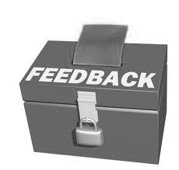
How can we help more?
If there are additional topics within the presentation slide deck or the simulation examples that you would like to see addressed, let us know.
If you would like to share any materials you have with other professors, Chemstations can be either a reference or a repository.

Slide 3
What are we going to cover today?
What does a process simulator do?
Best practices
Common mistakes

Slide 4
What does a process simulator do?
Calculate heat and mass balances around unit operations & whole processes
Calculate what happens with vapor, liquid, solid in unit operations: cooling, heating, separating, or changing phase

Slide 5
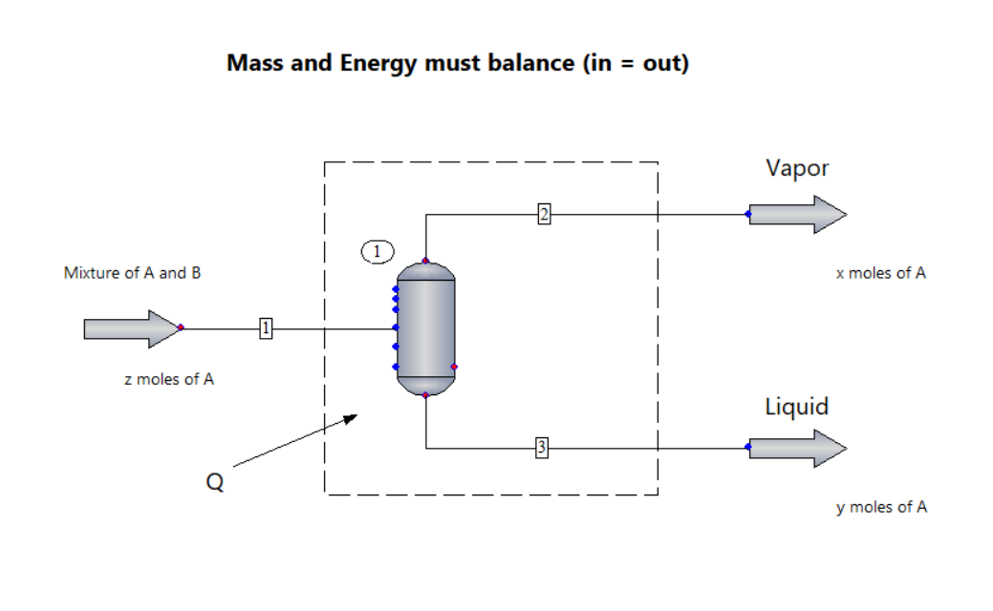
Mass & Energy Balance
Notes:
From the laws of thermodynamics, we know that mass & energy must balance
For steady state simulation, CONVERGENCE means In = Out within tolerances
Is there a phase change within the boundary limits of our system?

Slide 6
What does a process simulator do?
Calculate heat and mass balances around unit operations & whole processes
Calculate what happens with vapor, liquid, solid in unit operations: cooling, heating, separating, or changing phase
Provide key information for calculation:
  Databank with physical properties of chemicals
  Thermodynamic models for vapor-liquid equilibria
  Mathematical models for common unit operations

Slide 7
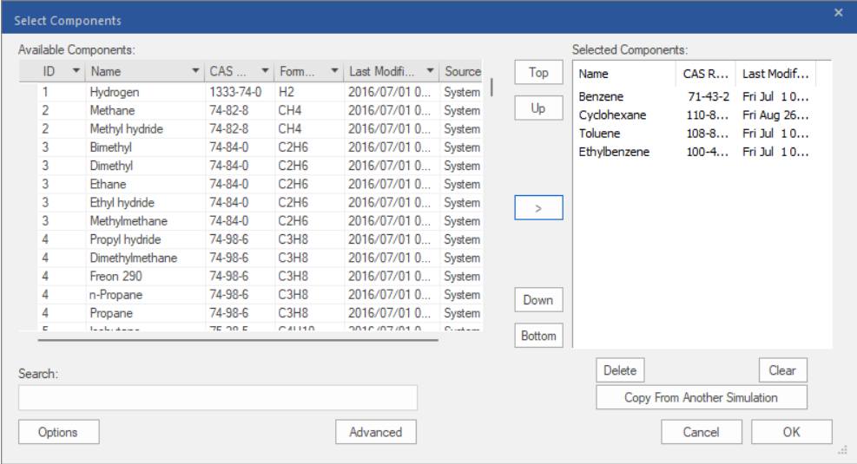
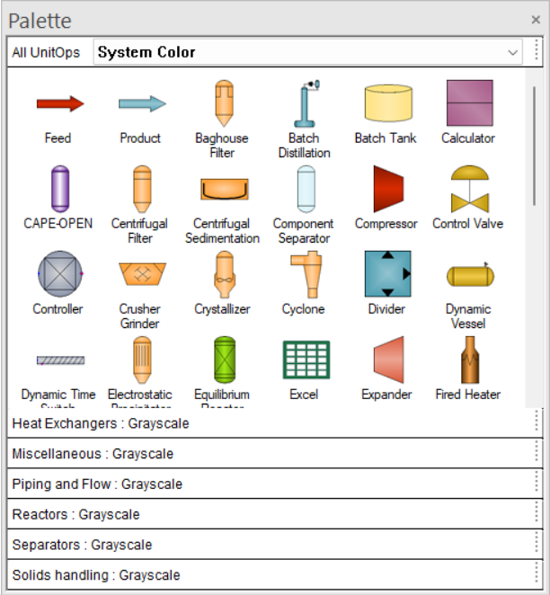
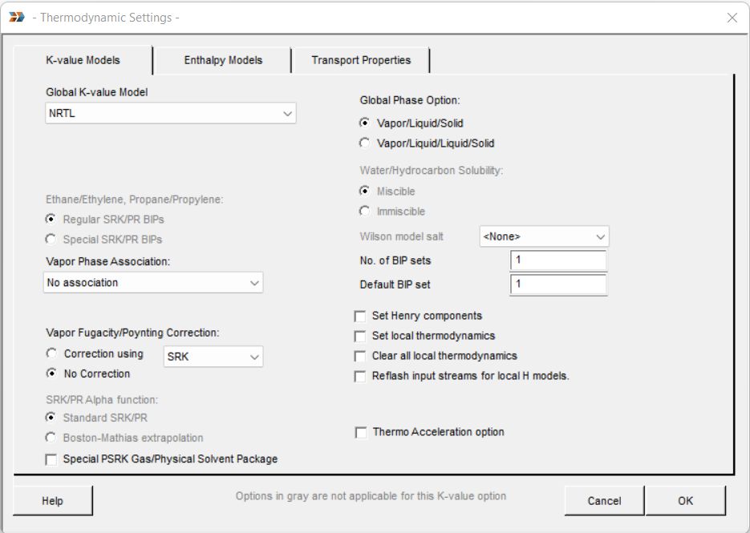
Databank, Equations, UnitOps
Notes:
CHEMCAD has over 2200 pure components & 40 VLE models
Handles all common unit operations with pre-programmed equations – drop-down menus allow you to adjust which equations are used based on your particular modeling need
Symbols may not look like actual equipment – some can actually represent more than one piece of equipment ex. compressor/turbine is same unit op
Some unit ops in a simulator only represent calculations and NOT actual physical equipment, ex. FLASH, CONTROLLER

Slide 8
What do engineers do with process simulators?
Model existing facilities
  Single unit or whole plant
  Troubleshoot issues
  Optimize energy/material use & costs
  Increase throughput
  Study what happens if conditions are different
Connect to control system for monitoring/control
Design new facilities
Notes:
Part of a plant can be as simple as one unit operation
Look for places to save money &/or increase revenue
Study what happens if conditions are different: ex. cooling water temps can vary greatly depending on the weather season & geographical location (can reach 92degF in Houston area in summer)
Real-time plant data can be fed into simulator to predict conditions and adjust parameters accordingly

Slide 9
Best Practices
Start with good physical property data
Choose & validate your thermodynamic model
Build model one step at a time
Handle recycles with care
Notes:
Steps you should consider with every simulation model
Will go into more detail on each of these…

Slide 10
Start with Good Physical Property Data
Which heat capacity curve is correct?
Notes:
Which one is correct? How do you know?
It’s the engineer’s responsibility to answer this question, not the simulator
Need to have some understanding of the system you’re dealing with

Slide 11
What is “good” physical property data?
Operational data is great
Pilot plant data is good
Lab data is OK
Literature data is . . . sometimes not bad
Predicted data is . . . brave
Notes:
Compare the data that you have to those in the simulator
Replace with your data if it differs and if you have greater confidence in it, ex. operational data vs. database data

Slide 12
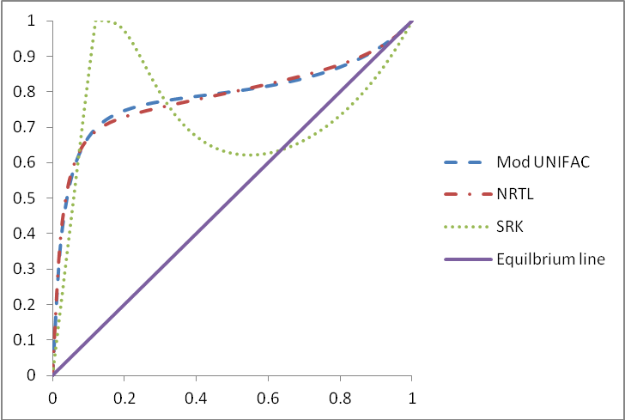
Learn How to Choose Thermodynamics
Notes:
Which model is correct?
Here again, it’s the engineer’s responsibility to answer this question, not the simulator
Could get very different answers depending on where you are on these curves
Plot properties for your system using different thermo models

Slide 13
How do you choose your thermo model?
Experience with thermo is necessary
Articles/books can teach you basics
Compare to data for important systems
Notes:
* See list of recommended articles/books included with undergraduate education material provided by Chemstations

Slide 14
Validate Your Thermodynamic Model
Inspect TPxy diagrams
Run some flash calculations & inspect results
Have a qualitative idea of what the phase separation will look like

Slide 15
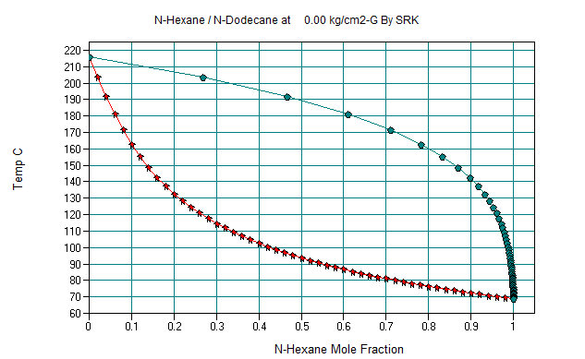
Learn How to Read Txy, Pxy, Txx, xy Diagrams
Notes:
Can plot all of these charts from within the simulator from the data included in the database
Just choose components and temp/pressure conditions

Slide 16
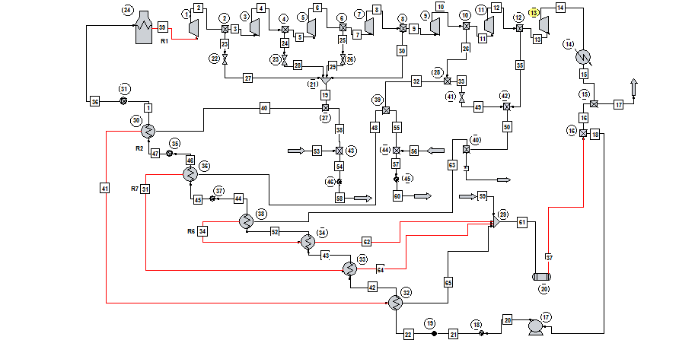
One step at a time!
Notes:
Don’t build this whole flowsheet and then hit “Run” … unless you’re having a contest to see who can get the most errors & warnings

Slide 17
Start Simple
Notes:
Add one unit op to the flowsheet
Get it to converge
Add a second
Repeat

Slide 18
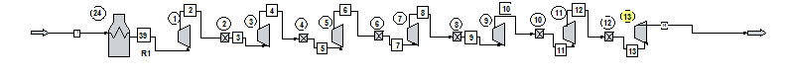
Add Piece-by-piece & Converge at Each Step

Slide 19
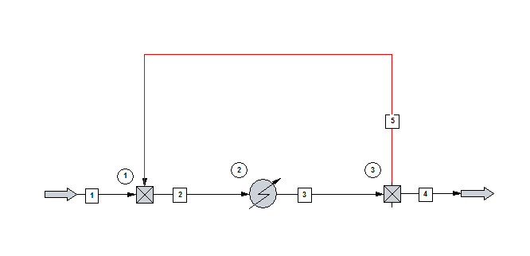
Handle Recycles with Care
Notes:
Think about the math you introduced by adding a recycle stream…

Slide 20
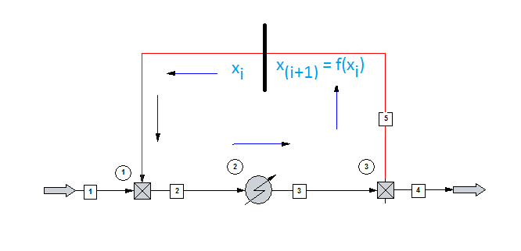
Calculations Get More Complicated
Notes:
Not only have to get Streams 1 & 4 to balance, but have to get recycle to converge

Slide 21
Put In a Good Initial Estimate
Specify this flow rate to stabilize calculations!
Let the simulator calculate this flow rate.
Notes:
* For easier convergence (stability of calculations), allow the program to adjust a variable outside of the recycle loop

Slide 22
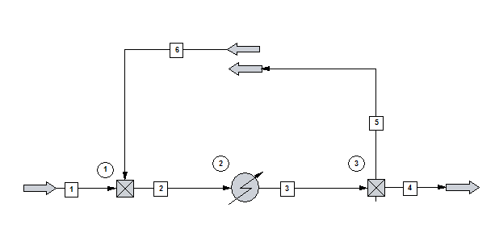
Start with Loop Open to Get Estimate
Notes:
Run initially with recycle open
Then copy flow of Stream 5 into Stream 6
Run again
Check if new Stream 5 value is close to Stream 6
Repeat if needed until values get close
Close recycle loop on flowsheet

Slide 23
Common Mistakes
Matching plant data
  How accurate are the measuring devices? Last calibrated?
  Were all measurements taken at same steady-state conditions?
  Are you ignoring trace chemicals?
  Neglecting to examine different conditions (cooling water can average 90 ˚F in Houston summer)
Notes:
These questions should be considered by engineer when evaluating accuracy of data and effect on model

Slide 24
Other Common Mistakes
A simulator is not a video game
  Converged doesn’t mean correct
Understand your process before modeling
  If you don’t know what you’re doing, you’ll get the wrong answer
These are tools; you are the engineer
  Garbage in = garbage out
  Use engineering judgment, not necessarily default options

Slide 25
Takeaways from Today
Process simulators are powerful tools to help make it easier to solve a wide range of engineering problems
You will encounter these tools when you graduate & should become familiar with them
Like any tool, it’s important to know how to properly use it to get the best results

Slide 26
Learn more!
Use a simulator to revisit homework problems!
Find a mentor! Find examples!
Learn TPxy plots . . . applied thermodynamics . . .
Read a book!
  Edwards, Chemical Engineering in Practice, Kindle edition
  Seider, Lewin, Product and Process Design Principles
  Kaes, Refinery Process Modeling
Read a magazine article!

